Slide 1


LO1: Explore innovative ways to manage and control BRT services
Juan Carlos Muñoz, Ricardo Giesen and Felipe Delgado
Departamento de Ingeniería de Transporte y Logística
Pontificia Universidad Católica de Chile

Slide 2
Metro
Attributes
Fast
Low waits
Comfort
Reliable
Main
drivers
Increase
Speed
Increase Frequency
Increase Capacity
Regular Headways
Segregated ways/lanes
Reduce dwell times
  Fare payment off-bus
  Buses with multiple doors
Increase distance between stations
Express services
Traffic signal priority
Improved headway control
Actions

Slide 3
Is keeping regular headways that difficult?

Slide 4
Bus Operations without Control
Bus
Waiting Passengers
Stop
Stop
Waiting
Passengers
Bus
Notes:
4

Slide 5
Bus Operations without Control
a small perturbation…
Waiting Passengers
Stop
Bus
Stop
Bus
Waiting
Passengers
Notes:
5

Slide 6
Bus Operations without Control
While one bus is still loading passengers the other bus already left its last stop
Stop
Bus
Stop
Bus
Notes:
6

Slide 7
Bus Operations without Control
Bus
Stop
Bus
Stop
Notes:
7
Now without any stochastic event to have more passenger waiting the delayed bus than the unloaded bus

Slide 8
Bus Operations without Control
Without bus control, bus bunching occurs!!!
Stop
Stop
Bus
Bus
Notes:
8

Slide 9
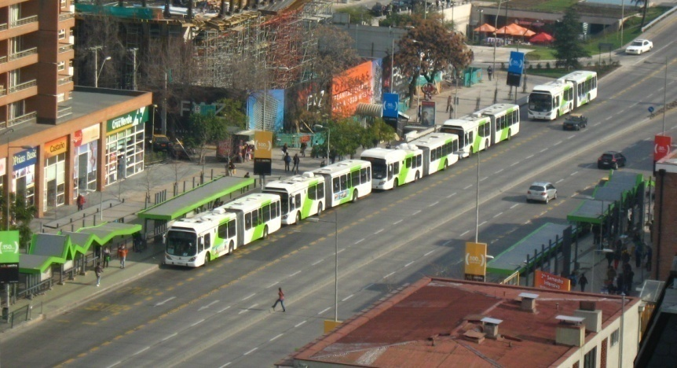
Santiago, Chile

Slide 10
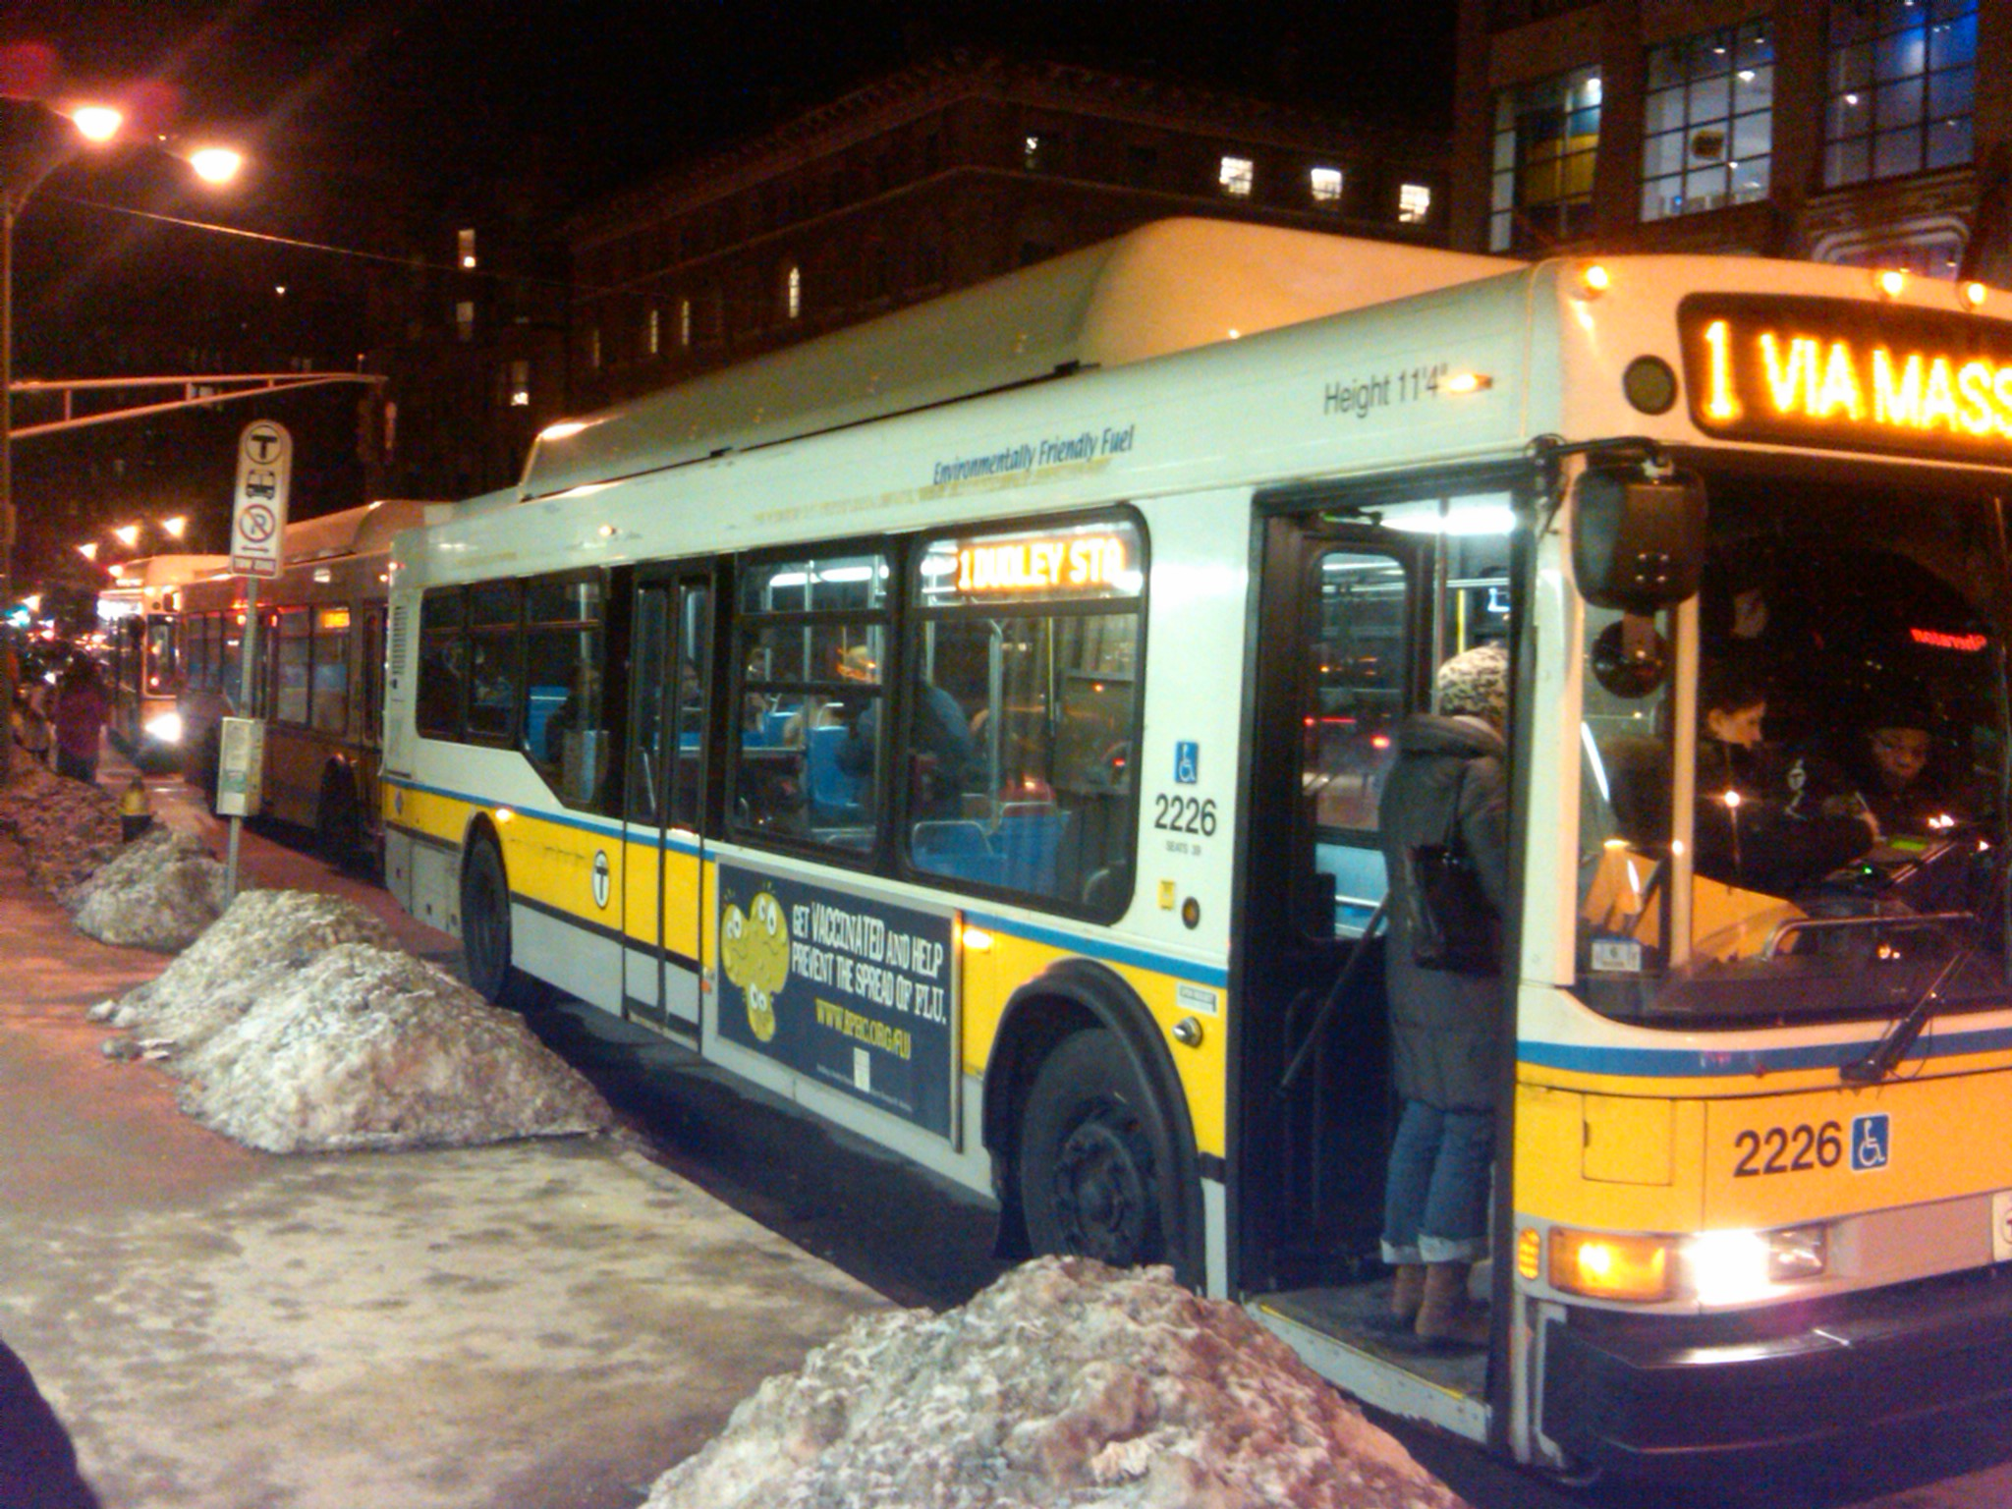
Boston, MA; line 1 during winter

Slide 11
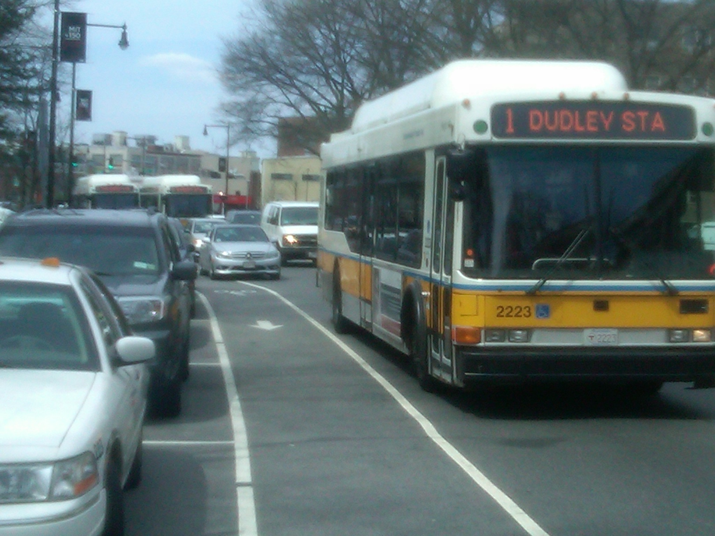
Boston, MA; line 1 during summer

Slide 12
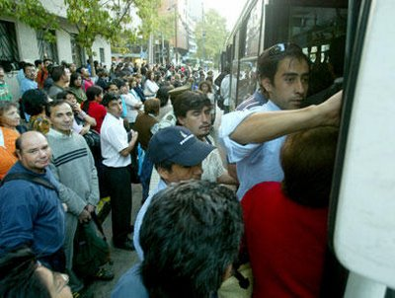
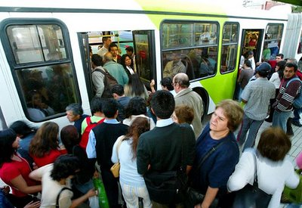
In systems where bus capacity is an active constraint, this is specially serious

Slide 13
Time-space trajectories
Line 201, March 25th, 2009
6:30 AM
8:30 AM

Slide 14
Bus bunching
Severe problem if not controlled
  Most passengers wait longer than they should for crowded buses
  Reduces reliability affecting passengers and operators
  Affects Cycle time and capacity
  Creates frictions between buses (safety)
  Put pressure in the authority for more buses
Contribution: Control Mechanism to Avoid Bus Bunching!
Notes:
Punto 1: corredor unidireccional, compuesto por un conjunto de paradas y de buses homogéneos con capacidad de pasajeros limitada.

Slide 15
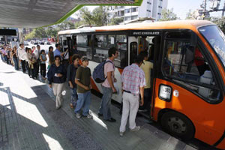
2. Objective
Propose a headway control mechanism for a high frequency & capacity-constrained corridor.
Consider three control strategies:
  Holding
  Boarding Limits
  Green extension for buses
Explore their impact (as single strategies and jointly) in waiting, reliability, capacity and comfort
Identify scenarios where each control strategy is recommended.
Passengers prevented from boarding
Passengers allowed to board
Notes:
Punto 1: corredor unidireccional, compuesto por un conjunto de paradas y de buses homogéneos con capacidad de pasajeros limitada.

Slide 16
3. Approach
Based on real-time information (or estimations) about:
    Bus position.
    Bus loads.
    # of Passengers waiting at each stop.
We run a rolling-horizon optimization model each time a decision (holding, boarding limits, traffic signals) must be made.
The model minimizes:
Time waiting for first bus + time waiting for subsequent buses + + time held + penalty for being prevented from boarding + + time waiting in cars

Slide 17
4. Experiment: Simulation Scenarios
One-way loop Transit corridor with 30 Stops
Scenario | Bus capacity is reached | Service frequency
1 | Yes | High
2 | No | High
3 | Yes | Medium
4 | No | Medium
Notes:
Short: 2.2 minutes
Medium: 5 minutes aprox

Slide 18
4. Experiment: Control strategies
Estrategias de control simuladas
      No control
        Spontaneous evolution of the system.
        Buses dispatched from terminal as soon as they arrive or until the design headway is reached.
        No other control action is taken along the route.
        Threshold control
        Myopic rule of regularization of headways between buses at every stop.
        A bus can be held at every stop to reach a minimum headway with the previous bus.
        Holding (HRT)
        Solve the rolling horizon optimization model not including green extension or boarding limits.

Slide 19
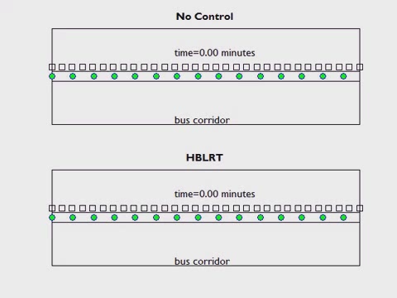
5. Results: Simulation Animation
Simulation includes events randomness
2 hours of bus operation. 15 minutes “warm-up” period.

Slide 20
Results
We will only show the impact of Holding only and for scenario # 1
For the other scenarios, impacts are similar
For the other strategies impacts are even higher

Slide 21
5. Results: Time savings
 | No | Threshold | HRT
 | control | control
Wfirst | 4552.10 | 1220.47 | 805.33
Std. Dev. | 459.78 | 310.43 | 187.28
% reduction |  | -73.19 | -82.31
Wextra | 1107.37 | 661.70 | 97.49
Std. Dev. | 577.01 | 1299.95 | 122.59
% reduction |  | -40.25 | -91.20
Win-veh | 270.57 | 6541.56 | 1649.28
Std. Dev. | 36.00 | 868.74 | 129.56
% reduction |  | 2317.74 | 509.57
Tot | 5930.03 | 8423.73 | 2552.10
Std. Dev. | 863.80 | 2377.11 | 390.01
% reduction |  | 42.05 | -56.96

Slide 22
5. Results: Time-space trajectories
No Control
Threshold

Slide 23
5. Results: Time-space trajectories
No Control
Threshold
HRT

Slide 24
5. Results: Bus Loads
No Control
Threshold

Slide 25
5. Results: Bus Loads
No Control
Threshold
HRT

Slide 26
5. Results: Cycle Time
No Control
Threshold

Slide 27
5. Results: Cycle Time
No Control
Threshold
HRT

Slide 28
5. Results: Waiting time Distribution
 | % of passengers that have to wait between:
 | Period 15-25 |  |  | Period 25-120
 | 0-2 min | 2-4 min | > 4 min | 0-2 min | 2-4 min | > 4 min
No Control | 57.76 | 29.60 | 12.64 | 63.46 | 27.68 | 8.86
Threshold Control | 78.15 | 20.64 | 1.21 | 82.52 | 16.46 | 1.02
HRT | 79.24 | 20.29 | 0.47 | 87.30 | 12.62 | 0.08

Slide 29
6. Conclusions
  Developed a tool for headway control using Holding, Boarding limits and green extension strategies.
  Time savings reach over 50% just with holding
  Extending it to green time extension and boarding limits savings can reach over 60% with only minor impact on car users
  Huge improvements in comfort and reliability
  The tool is fast enough for real time applications.

Slide 30
Publications and working papers
Delgado, F., Muñoz, J.C., Giesen, R., Cipriano, A. (2009) Real-Time Control of Buses in a Transit Corridor Based on Vehicle Holding and Boarding Limits. Transportation Research Record, Vol 2090, 55-67
Munoz, J.C. and Giesen, R. (2010). Optimization of Public Transportation Systems. Encyclopedia of Operations Research and Management Science, Vol 6, 3886-3896.
Delgado, F., J.C. Muñoz and R. Giesen (2011) How much can holding and limiting boarding improve transit performance? Submitted to Trans Res Part B.
Muñoz, J.C., C. Cortés, F. Delgado, F. Valencia, R. Giesen, D. Sáez and A. Cipriano (2011) Comparison of dynamic control strategies for transit operations. Submitted to Trans Res Part C.

Slide 31
Conferences and seminars
Delgado F., Muñoz J.C., Giesen R. (2011) An Integrated Real Time Transit Signal Priority Control For High Frequency Transit Services. i) Workshop Land Translog II, Puerto Varas, Chile, 12-15 December. and ii) Thredbo, Durban, Sudáfrica, 11-15 September.
Delgado F., Muñoz J.C., Wilson, N. and Wong, C. (2011) Operation Control Strategies to Improve Transfers Between High-Frequency Urban Rail Lines. IFORS 2011, Melbourne, Australia, 10-15 July.
Raveau S., Delgado F., Muñoz J.C., Giesen R. (2010) Aproximación Continua al Fenómeno de Apelotonamiento de Buses. XVI Congreso Panamericano de Transporte y Logística, Lisboa, Portugal, 15-18 Julio.
Muñoz J.C., Giesen R., Delgado F., Cipriano A., Cortés C., Sáez D., Valencia F. (2010) Comparison of Control Strategies for Real-time Optimization of Public Transport Systems. TRISTAN VII, Tromsø, Noruega, 20-25 June.
Seminars at Berkeley, GeorgiaTech, MIT, Northwestern University, Bucaramanga and Bogota

Slide 32
2012

Slide 33
In-progress or future research I
Microsimulation tests. Microsimulate our results with the tool developed by EMBARQ (MEng Student Felipe Ortiz)
How can we smartly reduce the computational time to make its implementation feasible for real world cases (MEng Student Felipe Ortiz)
How do you control buses in a corridor when there is more than one service. We need to consider that some passengers may take any of them and some need to take only one. (MSc Student Daniel Hernandez)
How to control if a set of the drivers cannot be reached (communication failure) or do not cooperate. (Eng student William Phillips)
How does the control mechanism operate if it is implemented with a delay (Eng student William Phillips)

Slide 34
In-progress or future research II
How can we incorporate bulk arrival of passengers as in a Metro station connecting two lines or in a Metro line feeding a bus service. (Felipe Delgado and Eng student Nicolas Contreras)
How can we control through traffic signals? How can we optimally mix it with traffic signals?
When should we prefer to reserve some vehicles from our fleet to be inserted in the operations to deal with irregularity? (work with MIT as part of MISTI project)
How can we use this control tool to deal with a big incident and a scheduled operation?
Develop an educational tool. (Felipe Delgado)

Slide 35
Educational impact
Educational tool
  We will be developing an educational tool oriented to anyone interested in learning about this problem. The goal will be to understand the problem by seeing how buses bunch and how this impacts the level of service to passengers.
  Then the user will try to control the buses manually and realize that the performance obtained is very poor if contrasted with a more robust and comprehensive approach.
  The game should build intuitions regarding what works and what does not.
We have added Felipe Delgado as a permanent faculty member at PUC.

Slide 36
Grants obtained
FONDECYT (2012-2014) Control strategies for buses in a corridor with multiple bus services. (US$150,000 requested, funds actually granted are still unknown)
  Ricardo Giesen (main researcher). Also Juan Carlos Muñoz, Felipe Delgado and Juan Carlos Herrera
MISTI (2012-2013) Urban Public Transport Operations Control (US$30,000)
  Nigel Wilson, John Attanucci, Juan Carlos Muñoz and Ricardo Giesen

Slide 37
From the papers to the streets
Several interviews with the media during 2011
Several interviews with authorities during 2011
Four pilot plans are being planned for headway control during 2012:
  Two trunk services of Transantiago (Buses Metropolitana and Inversiones Alsacia),
  A BRT corridor in Bucaramanga, Colombia
  Metro of Santiago

Slide 38
LT1: Explore innovative ways to manage and control BRT services
Juan Carlos Muñoz, Ricardo Giesen and Felipe Delgado
Departamento de Ingeniería de Transporte y Logística
Pontificia Universidad Católica de Chile

